Slide 1




Master UGA SSD 2024-2025 M1 - Supervised Project
Prognostic biomarkers in colon cancer
Supervisors: Ekaterina BOUROVA-FLIN¹ et Séverine VALMARY-DEGANO^{1,2}
¹ Team “Epigenetic Regulations”, Institute for Advanced Biosciences (IAB), Grenoble
² Centre Hospitalier Universitaire Grenoble Alpes (CHUGA) 21/10/2024

Slide 2
Outline
Part I. Presentation of the Institute
Part II. Scientific background
II.1 Introduction
II.2 Methods
II.3 Results
Part III. Presentation of the supervised project

Slide 3
Outline
Part I. Presentation of the Institute
Part II. Scientific background
II.1 Introduction
II.2 Methods
II.3 Results
Part III. Presentation of the supervised project

Slide 4
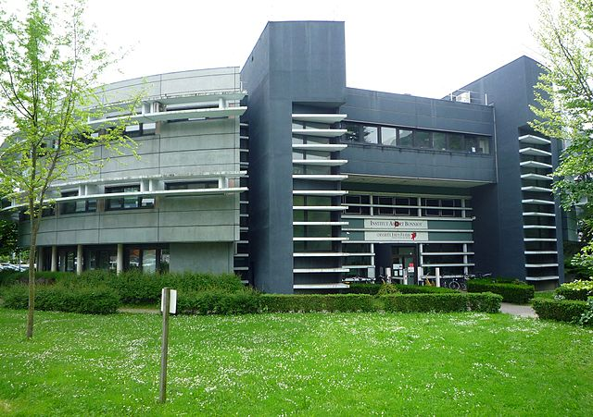
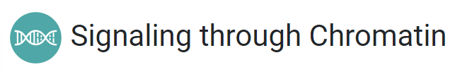
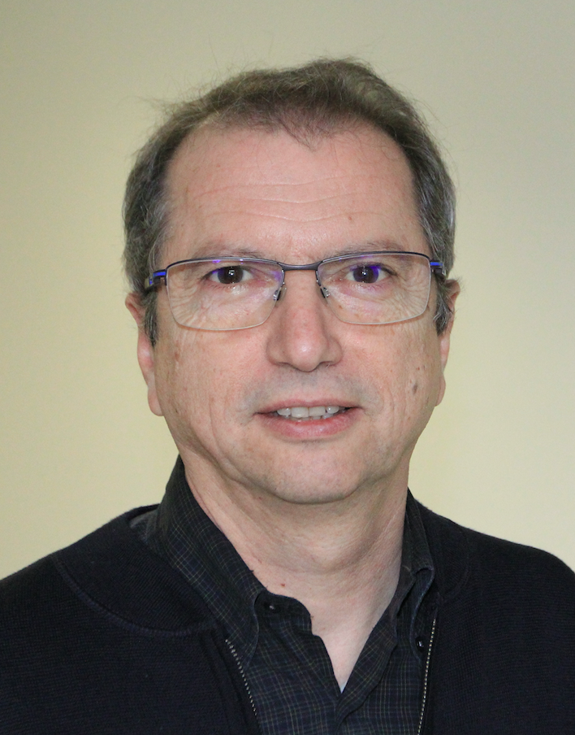

Institute for Advanced Biosciences
Team « Epigenetic Regulations »
18 permanent staff
biologists
computer engineers
medical doctors
4 PhD students
3 Master students
UGA, INSERM, CNRS
3 departments
19 teams
300 people
Saadi Khochbin
(Team Leader)
Bioinformatic facility « EpiMed »

Slide 5

Outline
Part I. Presentation of the Institute
Part II. Scientific background
II.1 Introduction
II.2 Methods
II.3 Results
Part III. Presentation of the supervised project

Slide 6
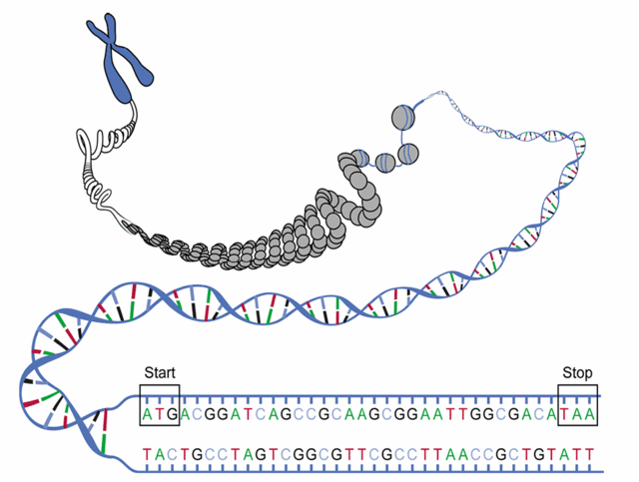
Epigénétique
20-ème siècle – La génétique
chromosome
La génétique (du grec « donner naissance ») est la science qui étudie l'hérédité et les gènes.
1909 – notion de gène, une base d’hérédité
1953 – découverte du double hélice d’ADN
1977 – séquençage des fragments d’ADN
2003 – séquençage complet du génome humain
chromatine
21-ème siècle – L’épigénétique
ADN
Épi : « au dessus de »
L’épigénétique étudie les mécanismes moléculaires qui modifient l'expression des gènes en fonction de l’environnement.
gène

Slide 7

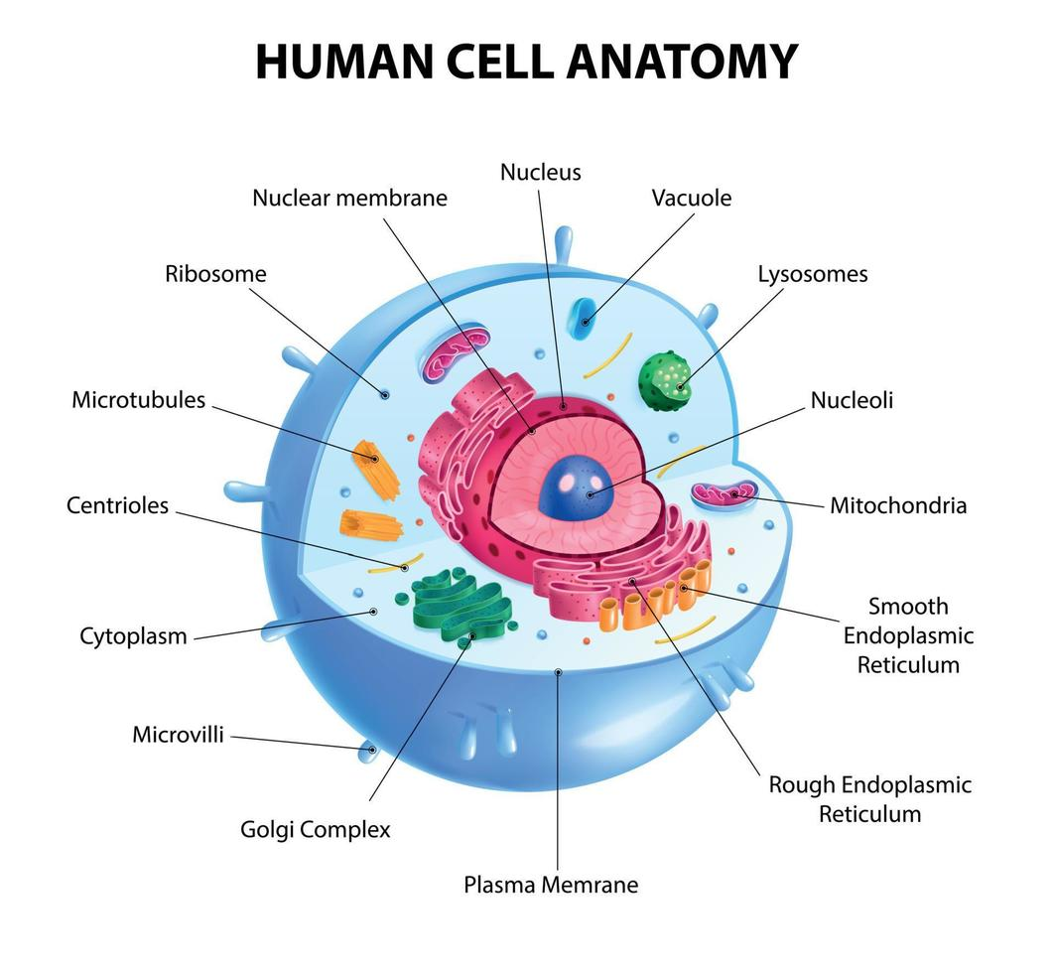


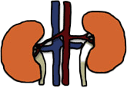
Epigenetic regulations
Heart
Liver
Lung
Kidney

Slide 8


Epigenetic regulations
Epigenetic system
DNA

Slide 9
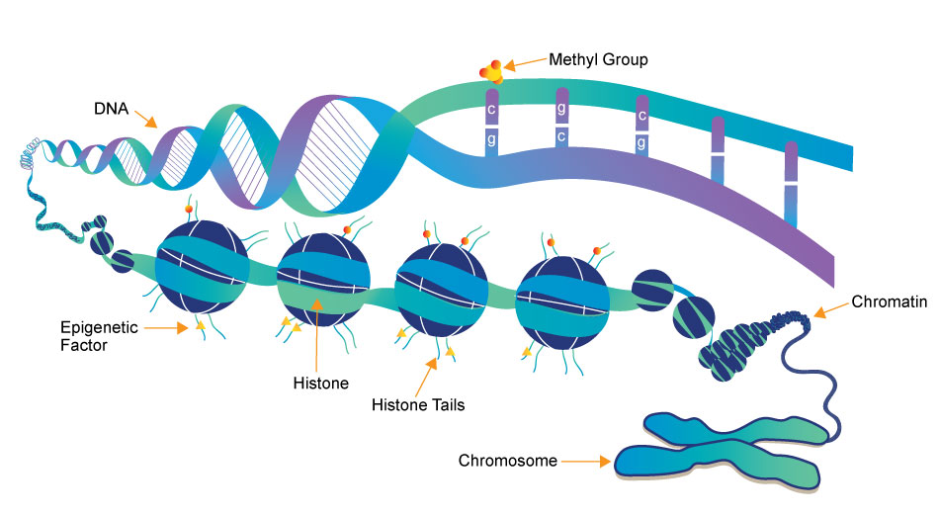

Epigenetic regulations
Chromosome

Slide 10

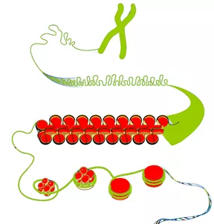
Aberrant (ectopic) activations of genes in cancers
Normal cells
Genes “ON”
Genes “OFF”

Slide 11


Aberrant (ectopic) activations of genes in cancers
Normal cells
Cancer cells
Genes “ON”
Genes “OFF”

Slide 12
Aberrant (ectopic) activations of genes in cancers
Normal cells
Cancer cells
OFF
ON

Slide 13
Aberrant (ectopic) activations of genes in cancers
Normal cells
Cancer cells
Tissue-specific genes
OFF
ON

Slide 14
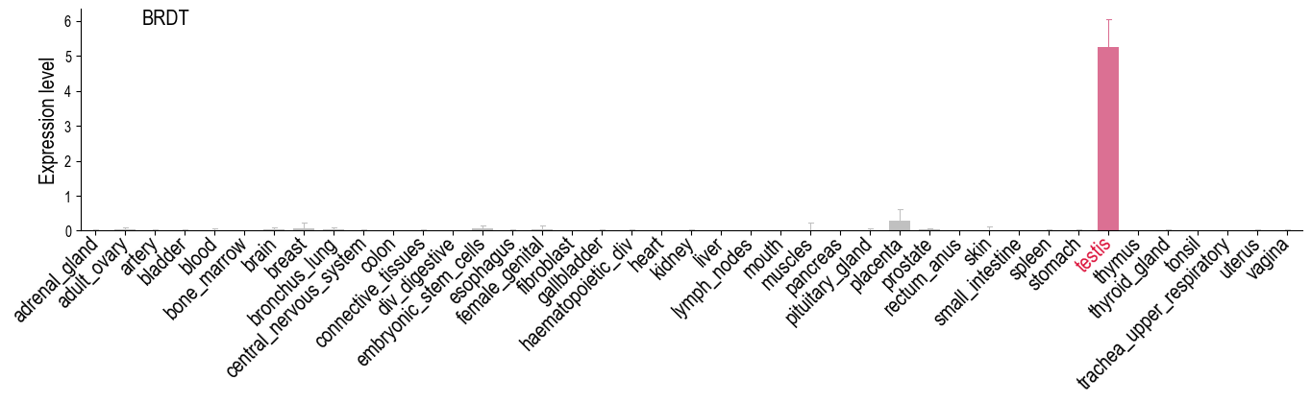
Tissue-specific genes in human normal tissues
Normal tissues (GTEX dataset)

Slide 15
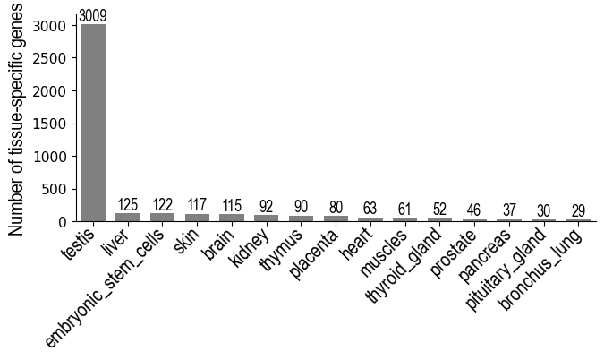
Tissue-specific genes in human normal tissues
In total, approximately 3 000 – 5 000 tissue-specific genes depending on applied criteria

Slide 16

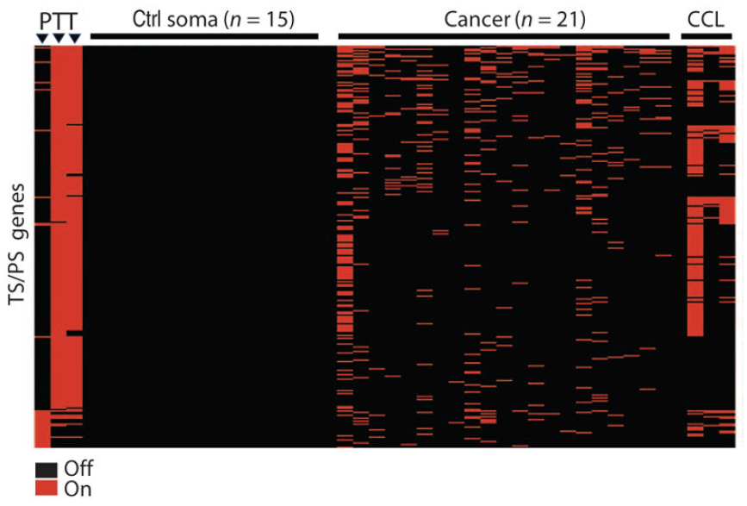
Tissue-specific genes in cancers
Rousseaux et al. 2013
1. Massively activated
NORMAL
CANCER
Testis- and placenta- specific genes
ON
OFF

Slide 17
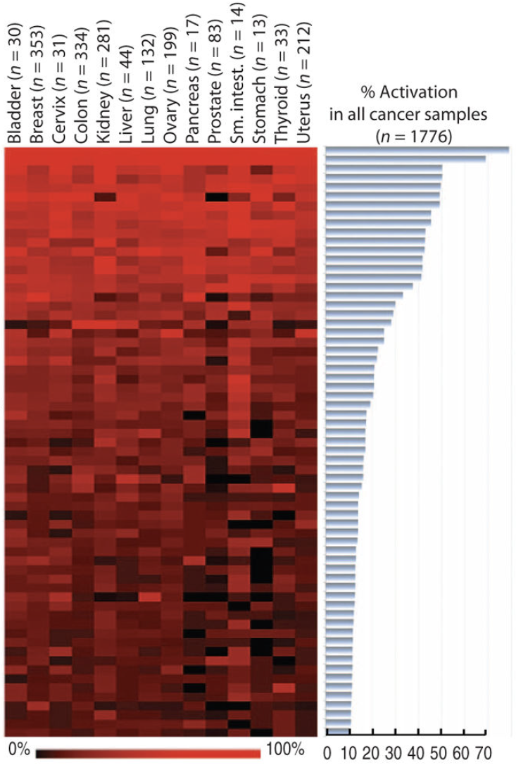
Tissue-specific genes in cancers
Rousseaux et al. 2013
1. Massively activated
2. In all cancer types
NORMAL
CANCER
Testis- and placenta- specific genes
ON
OFF
Testis- and placenta- specific genes

Slide 18
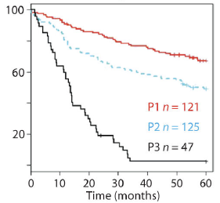
Tissue-specific genes in cancers
Rousseaux et al. 2013
1. Massively activated
2. In all cancer types
3. Aggressive forms
“ON” status = poor prognosis
NORMAL
CANCER
OFF
Testis- and placenta- specific genes
ON
OFF
Survival probability
Testis- and placenta- specific genes
ON
Novel source for discovery of prognosis biomarkers in cancers

Slide 19
Outline
Part I. Presentation of the Institute
Part II. Scientific background
II.1 Introduction
II.2 Methods
II.3 Results
Part III. Presentation of the supervised project

Slide 20

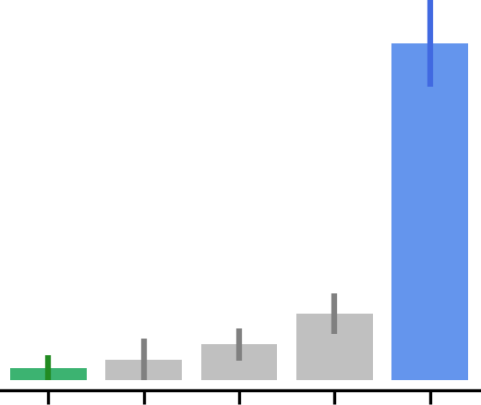
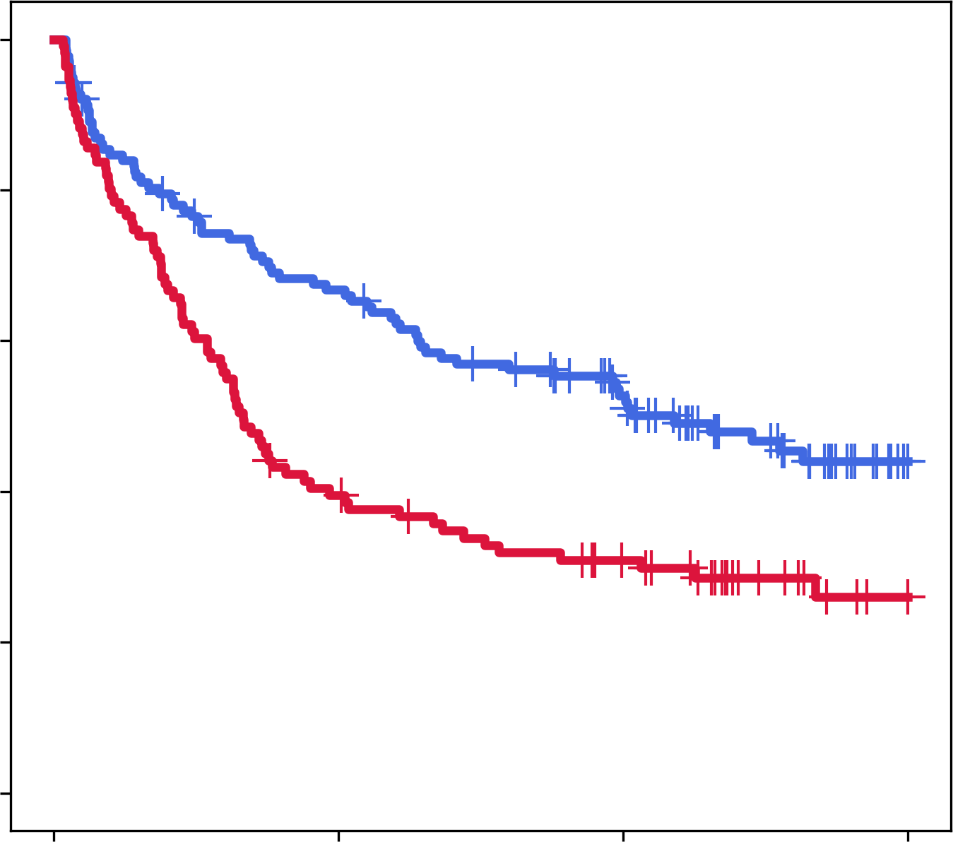


Biomarker discovery pipeline “ectopy”: Overview
1
2
3
Tissue-specific genes, OFF in normal samples
Activation is associated with a shorter survival
Frequently activated in cancer
OFF
ON
OFF
ON
REF
Testis

Slide 21
Biomarker discovery pipeline “ectopy”: Survival analysis
Training dataset
Validation datasets
Test datasets

Slide 22
Biomarker discovery pipeline “ectopy”: Survival analysis
Training dataset
Validation datasets
Test datasets
Permutations and cross-validations
Robust candidates: A, B, C…

Slide 23


Biomarker discovery pipeline “ectopy”: Survival analysis
Training dataset
Validation datasets
Test datasets
Permutations and cross-validations
Select stable candidates
A
B
C
Robust candidates: A, B, C…
Prognostic classifier (GEC)

Slide 24
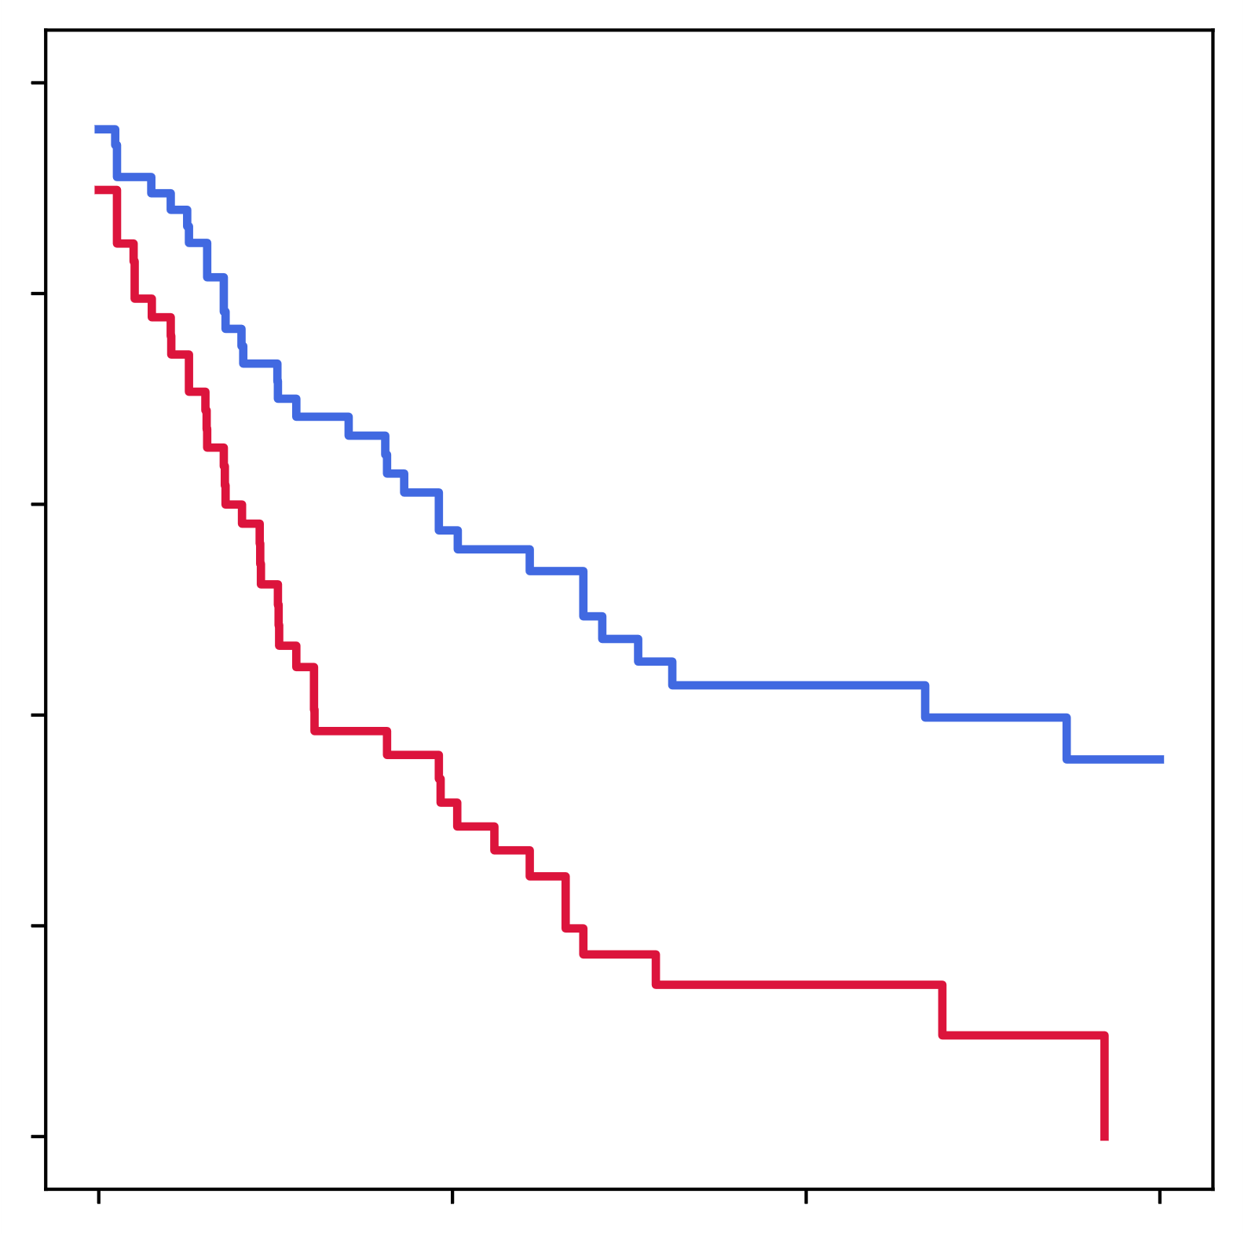
Biomarker discovery pipeline “ectopy”: Survival analysis
Training dataset
Validation datasets
Test datasets
Permutations and cross-validations
Select stable candidates
Test GEC
A
B
C
Robust candidates: A, B, C…
Prognostic classifier (GEC)
OK?

Slide 25
Outline
Part I. Presentation of the Institute
Part II. Scientific background
II.1 Introduction
II.2 Methods
II.3 Results
Part III. Presentation of the supervised project

Slide 26
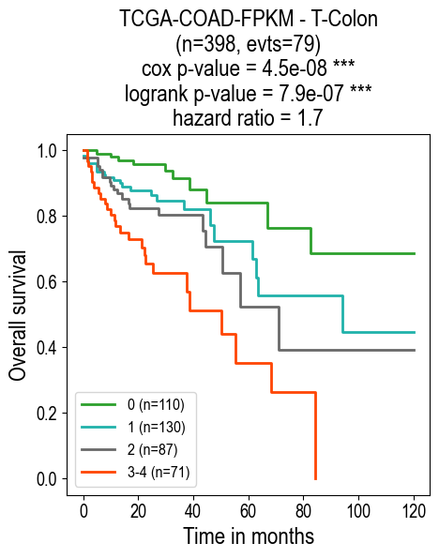
Colon cancer
Gene Expression Classifier (GEC): 4 biomarkers
HOXC6, ULBP2, ERFE, LAMP5
GEC score = number of activated biomarkers, from 0 to 4
GEC score

Slide 27
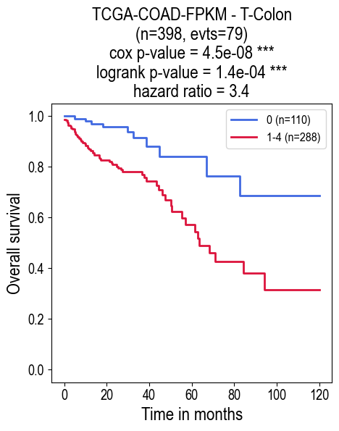
Colon cancer
Gene Expression Classifier (GEC): 4 biomarkers
HOXC6, ULBP2, ERFE, LAMP5
favourable
prognosis
(GEC-)
GEC score = number of activated biomarkers, from 0 to 4
GEC score
unfavourable
prognosis
(GEC+)

Slide 28
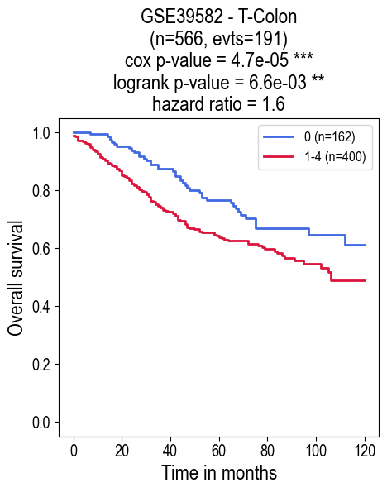
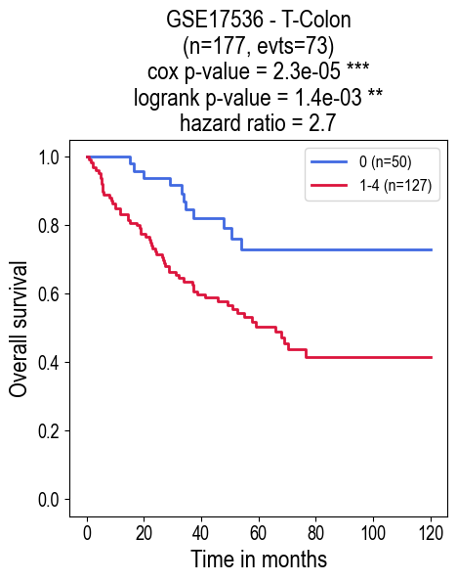
Colon cancer
Training dataset
Validation dataset
Test dataset

Slide 29
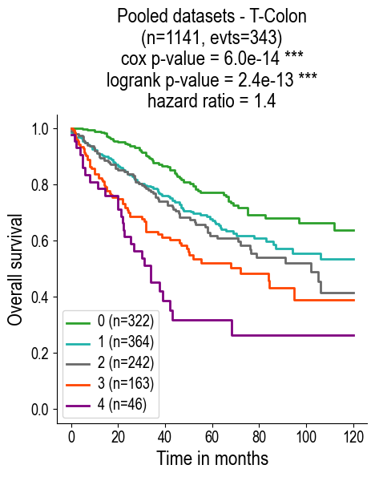
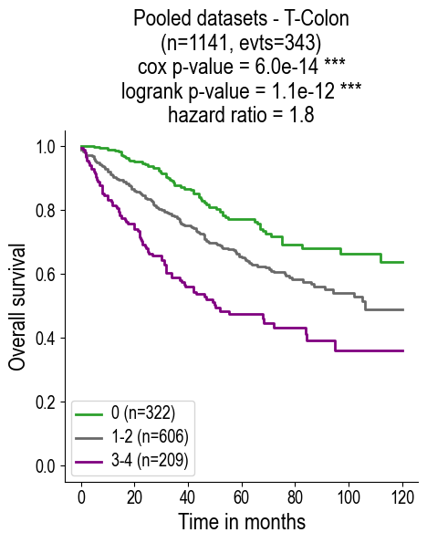
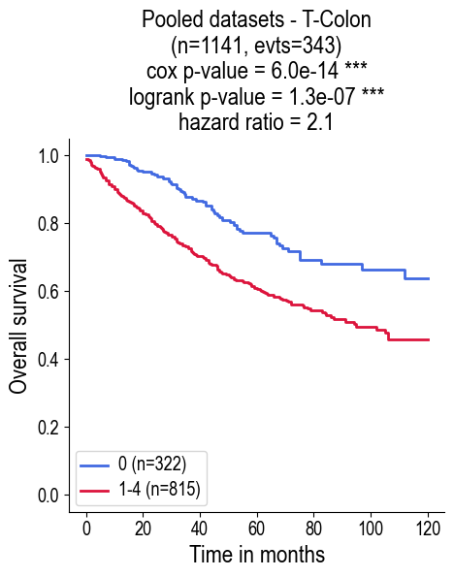
Colon cancer
Pooled datasets
GEC-
GEC+

Slide 30
Outline
Part I. Presentation of the Institute
Part II. Scientific background
II.1 Introduction
II.2 Methods
II.3 Results
Part III. Presentation of the supervised project

Slide 31

Main objectives
Supposing that the prognostic GEC score has been already calculated for each patient in 3 colon cancer public datasets:
Identify subtypes of colon cancer in the TCGA-COAD dataset These subtypes are not directly available in clinical annotations. They should be defined from an analysis of multi-omics data (mutation, methylation, copy number alteration and expression) available in the TCGA-COAD dataset
Predict the subtypes in two other datasets of colon cancer for which only transcriptomic data are available: GSE39582 and GSE17536 Several approaches are possible: machine learning, differential analysis, GSEA analysis using published molecular signatures in the MSigDB database
Analyze the GEC score in different subtypes of colon cancer Main subtypes of interest: Microsatellite instability (MSI), KRAS mutations, …
[Optional objectives] Analysis of correlation between ectopic activations and epigenetic deregulations in colon cancer

Slide 32
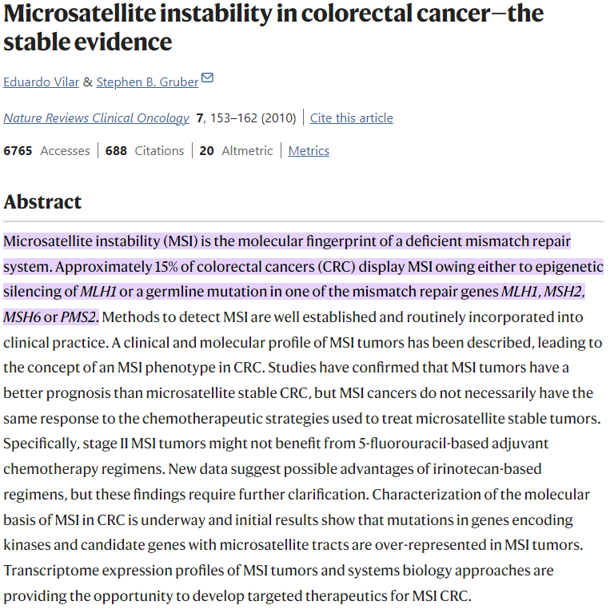
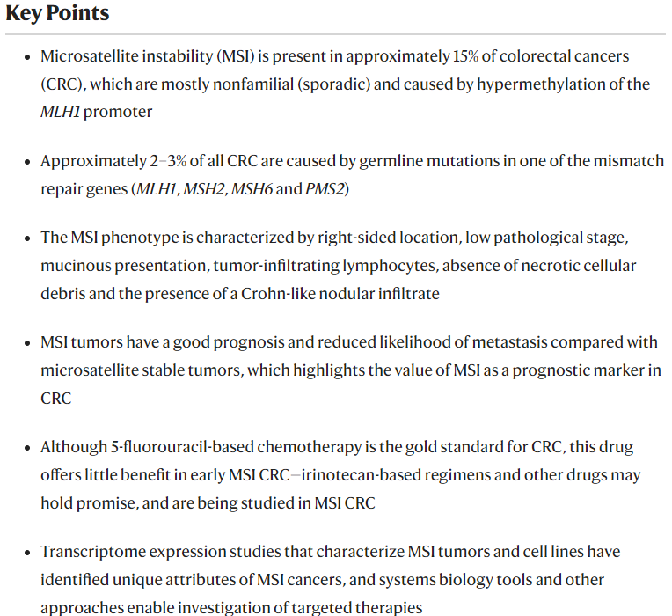
Microsatellite instability

Slide 33
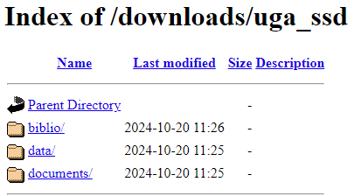
Access to data and documents
http://epimed.univ-grenoble-alpes.fr/downloads/uga_ssd/

